Slide 1

Marketing To An Audience of One
Customer Analytics for Individualized Marketing
Loyalty Builders Capabilities Overview
March 2014
© Loyalty Builders, Inc. 2014
1

Slide 2
What Loyalty Builders does
Customer marketing analytics
Analyze transaction data at the individual customer level
Produce metrics for each customer
  Describing their past behavior
  Predicting their future behavior
Predict what each customer is likely to buy next
“More revenue from existing customers”
© Loyalty Builders, Inc. 2014
2
Notes:
If you don’t analyze at the individual level, you can’t predict at the individual level

Slide 3
How we do it
Feed transaction data into an…
Automated analytical engine
Putting the results into a customer marketing database that feeds…
A cloud-based campaign builder and reporting tool, the whole being called…
The Longbow system
Supported by a 3 person account team
© Loyalty Builders, Inc. 2014
3

Slide 4






How the Longbow system works
Upload
Upload
your
customer
transaction
data to
Longbow.
Predict
Longbow's
automated
analytic engine predicts your customers'
cross-sell and
up-sell
opportunities.
Target
Use Longbow's
metrics and
filters
to identify
appropriate
customers
to target.
Campaign
You send individualized marketing
campaigns
to your
targeted
customers.
Monitor
Monitor
company
performance,
customer
behavior, and campaign
results.
© Loyalty Builders, Inc. 2014
4

Slide 5
What Longbow delivers
Metrics for every customer
  Loyalty Score: measures customer value
  Purchase Delay: identifies who is off usual buying pattern
  Risk Score: probability of defecting
  Likely Buyer Score: probability of making a purchase soon
Purchase propensities
  Up-sell and cross-sell product predictions
© Loyalty Builders, Inc. 2014
5

Slide 6
Sample data – what you’ll get
Unlike others, we analyze every customer on the individual level.
Then we deliver files that tell you which customers to target and what to offer them (both up-sell and cross-sell).
Customer ID | Segment | Loyalty Rank | Risk Score | Likely Buyer Score | Total Amount | Number of Orders | Category Score | Purchase Delay | Retention (days) | Recency (days)
49477905 | Nurturers | 90.06 | 7% | 21% | $405.20 | 18 | 1 | 0.5 | 1004 | 27
5428083 | Underperformers | 90.26 | 24% | 11% | $448.65 | 7 | 7 | 0.6 | 1032 | 93
37685106 | Faders | 54.02 | 53% | 3% | $444.05 | 7 | 11 | 2.8 | 794 | 254
52898993 | 1&2xBuyers | 63.37 | 62% | 3% | $58.60 | 2 | 4 | 0.3 | 674 | 164
36710971 | Loyalists | 98.56 | 5% | 23% | $979.65 | 25 | 14 | 0.1 | 1064 | 5
Customer ID | Up-sell Categories | Up-sell Probability | Cross-sell Categories | Cross-sell Score
36710971 | BAKED GOODS - COOKIES | 19% | CHOCOLATES | 9.160
36710971 | CANDY | 16% | REMEDIES | 6.887
36710971 | JAMS JELLIES CONDIMENTS | 15% | FRUITS NUTS | 6.836
36710971 | BAKED GOODS--MISC | 13% | CANNED GOODS - MEAT/FISH | 6.679
36710971 | TEA COFFEE DRINK | 10% | MAPLE GOODS | 6.518
The second table shows the up-sell and cross-sell product predictions
for the highlighted customer.
These predictions are used to build the individualized communications.
© Loyalty Builders, Inc. 2014
6
Notes:
NOTES:
Top Table:
Purchase delay: How many purchases someone has missed, based on their usual buying cycle.
Bottom Table:
Note that Up-sell Probability is shown as a percentage; Cross-sell Score is an index; cross-sell is a propensity, not a probability.
Cross-sell scores go from 0 – 10: 0 means you won’t buy, 10 means you’re buying it but getting it from a competitor.
Any Cross-sell score above a 5 – 6 is worth campaigning to.
Note that Up-sell and Cross-sell items in the table are noted at a CATEGORY level because this is the product hierarchy level at which most companies market
most companies don’t have the capability to market at the SKU level

Slide 7
Why use Longbow
Increase revenue and response rates with individualized marketing campaigns
Easy download access to affinities table,
up-sell predictions, and cross-sell propensities
Point-and-click campaign list builder
Quick, automated file creation for ESPs and printers
Accurately forecast a campaign before launch
Track KPIs in a marketing metrics dashboard
© Loyalty Builders, Inc. 2014
7

Slide 8
How our clients use this information
Individualized direct marketing
  Email
  Postcard
  If a campaign has a million recipients, each one receives a unique communication with product offers tailored to what the analytics predicts they are likely to buy
Website optimization
  Product affinities, purchase propensities
Inbound sales
  Call centers
Outside sales
© Loyalty Builders, Inc. 2014
8

Slide 9




Individualized marketing overview
Response rate
Data type
Analysis level
10% off all baseballs!
Contact information only
Entire customer population
Spray and pray:
same static message to all
Demographic data
Segment or product group
Transaction data
Individual customer
Many 1000’s of
individualized
communications
© Loyalty Builders, Inc. 2014
9
Notes:
Segment or product group analysis typically uses logistical regression
Loyalty Builders uses Finite State Machine methodology for individualized analytics

Slide 10
Why individualization matters – relevance raises response rates
1
To grow revenue, businesses must either win new customers or sell more to the ones they have.
Customer acquisition is difficult & expensive; selling to existing customers is easier and cheaper, and they are already the source of most of your revenue.
2
You can either sell them what they’ve previously purchased (up-sell) or what they’ve not yet bought (cross-sell); up-sell maintains the revenue stream; cross-sell grows it.
3
4
Cross-sell is the best way to grow revenue.
5
Effective cross-sell needs relevant, individualized offers.
© Loyalty Builders, Inc. 2014
10

Slide 11
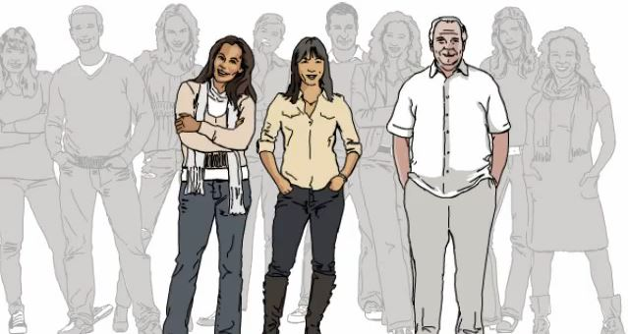
Individualized marketing – the movie
Watch our 3 minute video on individualized marketing at:
http://www.youtube.com/watch?v=0O0LNXyCwz8
© Loyalty Builders, Inc. 2014
11

Slide 12
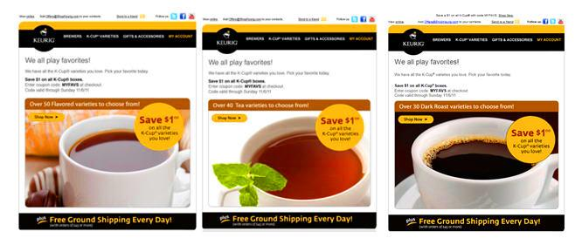
Client success:
Keurig case study – roast profiling
Customization by roast profile summary:
Over 800,000 emails sent
250,000 emails sent in control group
Customized emails produced 3x to 4x more revenue
Over 65% lift in number of buyers for Dark and Decaf
 | Open Rate | % of Open | Rev/Email | Lift/Email
Tea | 34% | 19% | $0.73 | $0.16
Dark | 54% | 27% | $2.19 | $1.62
Decaf | 49% | 29% | $1.90 | $1.33
Flavored | 43% | 22% | $1.27 | $0.70
Light/Med | 42% | 22% | $1.34 | $0.77
Control | 30% | 16% | $0.57 | $0.00
This campaign was nominated for most innovative marketing campaign award by MITX.
© Loyalty Builders, Inc. 2014
12
Notes:
Note that this is an example of Customization, not individualized marketing

Slide 13
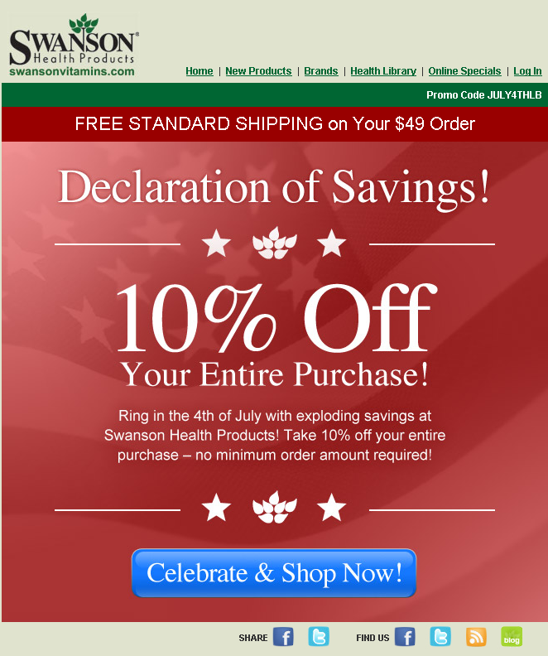
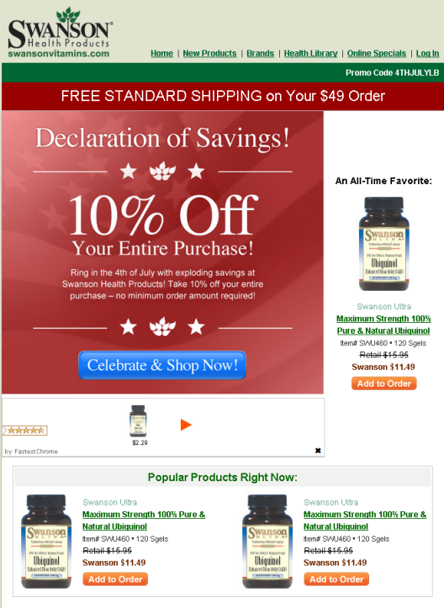
Client success:
Swanson Health Products retailer email case study
Business as Usual
Individualized
Loyalty Builders individualized Swanson emails by adding products recommended for each customer
This individualization increased revenue per email by $0.42
Loyalty Builders methodology outperformed previous methods, which translates into $314,700 additional revenue from 749,289 individualized emails
What Individualization Accomplishes
# of individualized emails | Revenue lift per email
749,289 | $0.42
© Loyalty Builders, Inc. 2014
13
Notes:
SPEAKER NOTES:
Swanson started with graphic at left and moved to an individualized email, shown to right.
The three pill bottles in the email on the right are merely template placeholders that are replaced at the time of send by customer-specific images
The email at right is a template which is simple to create; Swanson left space in the template to add in different products.
This is an good example of how Longbow can scale (evidenced by the number of emails highlighted in this example: 749,289)

Slide 14

Client success: Tire Discounters – targeting
Outstanding Campaign Results
17.8% of customers responded to the mailer, more than double of control group
Tire discounters realized $10.41 of revenue lift per each $.50 mailer
Group | Customer Count | Buyers | Buyers % of total | Revenue | Revenue per buyer | Lift in number of buyers | Revenue lift from additional buyers | Revenue lift per mailer
Received mailer | 10,347 | 1,840 | 17.8% | $177,625 | $96.54 | 1,021 | $98,600 | $10.41
Control group | 9,998 | 791 | 7.9% | $67,581 | $85.44
Random group | 10,000 | 186 | 1.9% | $16,936 | $91.05
© Loyalty Builders, Inc. 2014
14
Notes:
SPEAKER NOTES:
If asked, here’s how the $10.41 Revenue lift per mailer was calculated
$10.41 is the difference between the following:
Total Revenue of the Received mailer group ($177,685) divided by the Customer Count of the Received mailer group (10,347) = $17.173
Total Revenue of Control group ($67,581) divided by the Customer Count of the Control group (9,998) = $6.760
The difference between these is $10.41
The difference between the Control group and the Random group:
The control group and the received mailer group were targeted as Likely Buyers, with products identified that they had some propensity to purchase
The control group is who we targeted but did not send anything to; they were exposed to Tire Discounter’s usual broadcast stream of radio and tv ads
The random group is 10,000 individuals we selected at random—no targeting

Slide 15

Client success: major pharmaceutical company – cross-sell
Cross-sell Program Success
Monthly cross-sell campaign, now into third year
Individualization of both postcards and email
Each piece of collateral features four cross-sell only products
 | Recipients | Cost per piece | Response Rates | Revenue per piece
Postal | 5,000 | $0.50 | 12% - 17% | $12 - $13
Email | 40,000 | $0.01 | 3% - 4% | $3 - $4
© Loyalty Builders, Inc. 2014
15
Notes:
SPEAKER NOTES:
This slide is an excellent opportunity to point out the following:
This is a long-term campaign (now in its third year)
This campaign is B2B
Depending on their likely buyer score, a different subset of customers falls into each mailing
Customers were also selected because they had multiple products with a high cross-sell propensity
This is completely cross-sell; every offer, every sale made as part of this campaign is an expansion of the share of wallet that our customer is getting from their customer
Marketing to various customer types such as prisons, hospitals, school, Dr.’s offices
Marketing a variety of products like bandages, facemasks, etc.

Slide 16




















A sampling of our clients
© Loyalty Builders, Inc. 2014
16

Slide 17
A typical engagement
Free Customer Opportunity Analysis
  http://www.loyaltybuilders.com/solutions/services/customer-opportunity-analysis
  Send data
  Webinar to report analysis results
  Identify initial campaigns and opportunities
Proof of Concept Trial
Extended Subscription Engagement
We also offer consulting services and single report purchase opportunities such as our factorial design testing service, affinities report, risk analysis service, cross-sell and up-sell opportunity reports, and a retention/churn analysis
© Loyalty Builders, Inc. 2014
17
Notes:
SPEAKER NOTES:
Three years is good. Five is better.
The more data, the more accurate the predictions.
In many cases, you have other data fields unique to your business or industry that can be added to the data set to enable more finely tuned results.
Our data concierge is there to help.

Slide 18
Next steps
Contact us to continue the conversation on getting more revenue from your existing customers
Email: krisn@loyaltybuilders.com
Phone: +1.701.936.1080
© Loyalty Builders, Inc. 2014
18

